Slide 1
Routing II 📩
Discussion 4
CS 168, Summer 2025 @ UC Berkeley
Slides credit: Sylvia Ratnasamy, Rob Shakir, Peyrin Kao, Iuniana Oprescu
Notes:
Slides template credit: Josh Hug, Lisa Yan

Slide 2
Logistics
Project 1B: Basic Traceroute
  Deadline: Thursday, July 3rd (you can still file an extension!)
Project 2: Routing
  Deadline: Thursday, July 10th
Midterm on July 22nd, 7-9pm (put it in your calendar)!

Slide 3
Routing
Link-State Routing
IP Addressing
Notes:
DV good for small environment; need LS for enterprise scale

Slide 4
Link State Routing
Each router knows its own local “link state”:
State of each link to its neighbor (up/down)
Associated costs
1
4
2

Slide 5
Link State Routing
Router floods its link state to all other routers.
Each router learns global network topology
Then, computes shortest path themselves!
  With Dijkstra’s, etc
1
4
2
Notes:
flooding = quickly send updates to all other nodes in the network

Slide 6
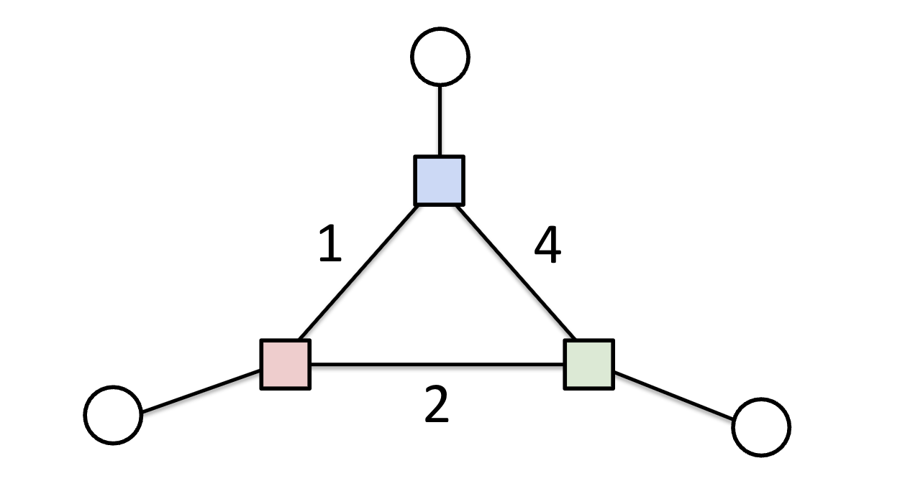
Link State Routing
Router floods its link state to all other routers.
Each router learns global network topology
Then, computes shortest path themselves!
  With Dijkstra’s, etc
1
4
2
Notes:
Every router in the topology:
○ Gets the state of all links and the location of all destinations.
■ Need some way to distribute this graph!
○ Uses that information to build a full graph.
■ Glue together all link/destination information received.
○ Finds paths from itself to every destination on the graph.
■ Run some algorithm over the graph.
○ Uses the next-hop (adjacent router) in those paths to populate the forwarding table.

Slide 7
Distance Vector vs Link State
Distance-Vector
  Global computation (distributed across all nodes)
  Only local data (local node plus whatever our neighbors told us).
Link-State
  Local computation
  Using global data (from all parts of the network)
Notes:
compare/contrast:
DV: global computation (distributed across all nodes) using local data
LS: local computation using global data/view (state of every link in network; own view of world, not just neighbors)
What is “global data”?
○ The state of every link in the network.
○ Is it up or down?
○ What is its cost?

Slide 8
Routing
Link-State Routing
IP Addressing

Slide 9
Requirements of Addressing
Scalable Routing
  Minimize state exchange needed to create paths
Efficient Forwarding
  Small forwarding tables
  Fast lookups
Host must be able to recognize packet is for them
  An end-to-end check on routing
  L3: IP addresses (dynamically assigned)
Notes:
-how to recognize? (MAC address for L2, IP address for L3)

Slide 10
IP Address
32 bits (for IPv4), split into 4 bytes, written in decimal (each decimal between 0 and 255)
Network prefix: /<bits>
  Size of network address, counting from the leftmost bit
  Example: 1.2.2.0/23
1.2.2.0/23
0000 0001 0000 0010 0000 0010 0000 0000
first 23 bits for network address
last 9 bits for host address
Notes:
-how to recognize? (MAC address for L2, IP address for L3)

Slide 11
Network prefixes (netmasks)
Prefix dedicated to network address
How can we tell if a host is in a network?
  Check if the prefix matches!
Mask: 123.96.0.0/12
01111011 . 01100000 . 00000000 . 00000000
Addr: 123.100.42.6
01111011 . 01100100 . 00101010 . 00000110

Slide 12



Classful Addressing
Network classes:
  A (/8): first 8 bits devoted to network
    First bit is fixed to 0.
    first byte from 0 to 127
    Can have ~16M hosts, only 2^7 = 128 nets.
  B (/16): first 16 bits devoted to network (first byte from 128 to 191)
    First two bits are fixed to 10
    Can have ~65K hosts, ~16K nets
  C (/24): first 24 bits devoted to network (first byte from 192 to 223)
    First three bits are fixed to 110
    Can have only 254 hosts (255 is reserved for last byte) ~2M nets
Network bits
Host bits
Host bits
Network bits
Network bits
Host bits
Notes:
-deprecated since the publication of RFC 1519 in 1993
-Class A far too big for most organizations
-Class C far too small for many organizations
-Class B is best option for many (still too big for many organizations and not that many of them)

Slide 13
Classful Addressing
Network classes:
  A (/8): first 8 bits devoted to network
  B (/16): first 16 bits devoted to network (first byte from 128 to 191)
  C (/24): first 24 bits devoted to network (first byte from 192 to 223)
Why is this a bad idea?
  Very limited choices lead to waste of addresses
Notes:
-deprecated since the publication of RFC 1519 in 1993
-Class A far too big for most organizations
-Class C far too small for many organizations
-Class B is best option for many (still too big for many organizations and not that many of them)

Slide 14
Classless Inter-Domain Routing (CIDR)
Use two 32-bit numbers to represent a network
  Network address = IP Address bitwise AND Subnet Mask
    IP Address is 192.138.12.2
    Subnet Mask is 255.248.0.0
Flexible division of bits:
  More choices for the size of the network and hosts
Offers better size routing table and efficient IP address space
network address 192.136.0.0/13
1100 0000 . 1000 1010 . 0000 1100 . 0000 0010
1111 1111 . 1111 1000 . 0000 0000 . 0000 0000
IP Address
Subnet Mask
Notes:
-make the number of fixed bits arbitrary
-allows more granular assignment
-how much wasted address space could there be? (50%)

Slide 15
Prefixes
Easy to Add New Hosts
  New host (5.6.7.213)
  Forwarding table doesn’t need to be updated!
1.2.3.4
1.2.3.7
1.2.3.156
5.6.7.8
5.6.7.9
5.6.7.212
host
host
...
host
host
host
...
host
LAN 1
LAN 2
router
router
router
host
WAN
WAN
5.6.7.213
1.2.3.0/24
5.6.7.0/24
forwarding table
Notes:
-This is more or less aggregation: multiple network addresses (5.6.7.*) being routed to the same output port, so aggregate them into a common entry (5.6.7.0/24)
-a shared prefix (makes table less cluttered)

Slide 16
Worksheet
Link-State Routing
More L3 Link State
IP Addressing

Slide 17
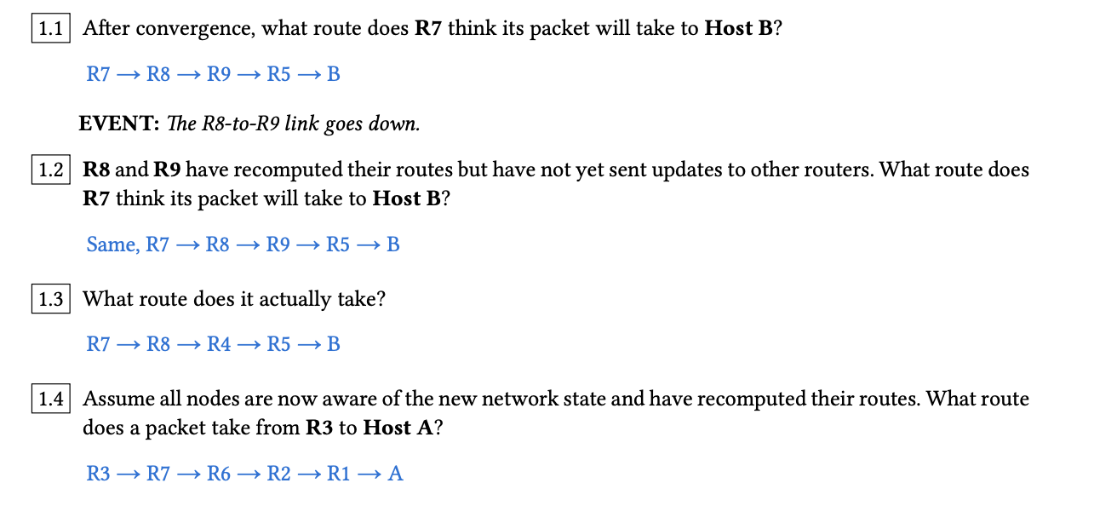

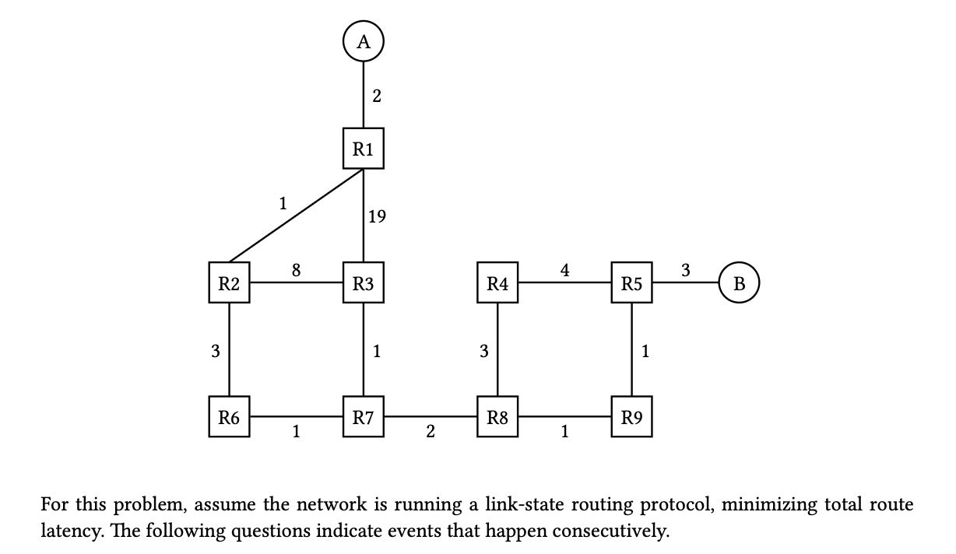
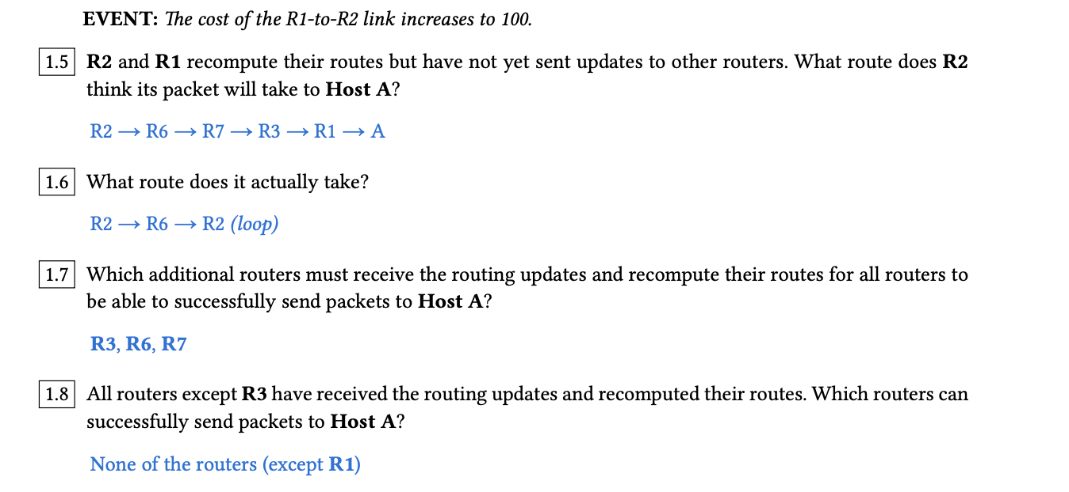
Question 1: Link-State Routing

Slide 18
Worksheet
Link-State Routing
More L3 Link State
IP Addressing

Slide 19
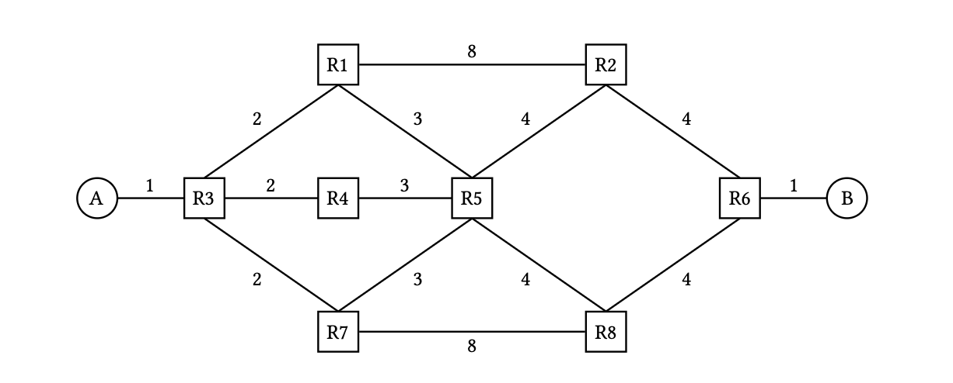
Question 2: More L3 Link State

Slide 20
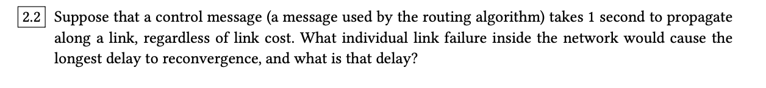
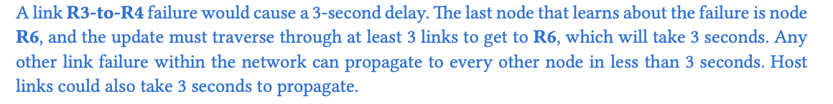
Question 2: More L3 Link State

Slide 21
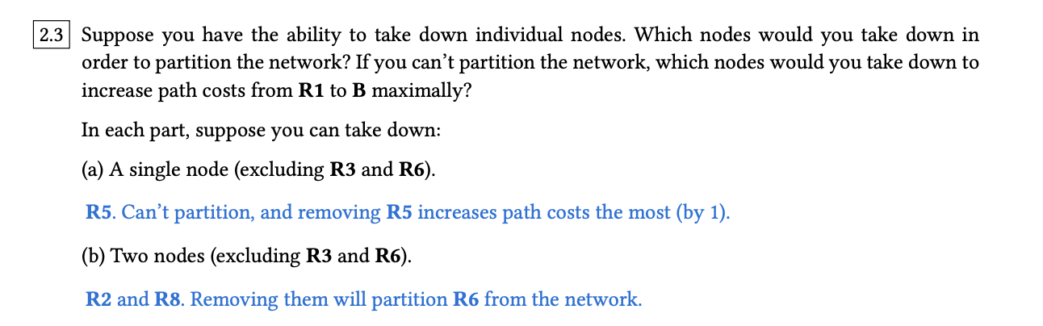
Question 2: More L3 Link State

Slide 22
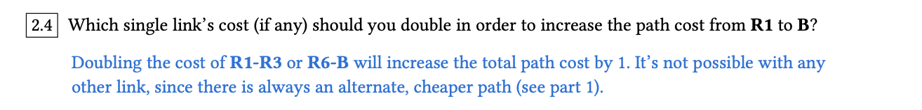
Question 2: More L3 Link State

Slide 23
Worksheet
Link-State Routing
More L3 Link State
IP Addressing

Slide 24
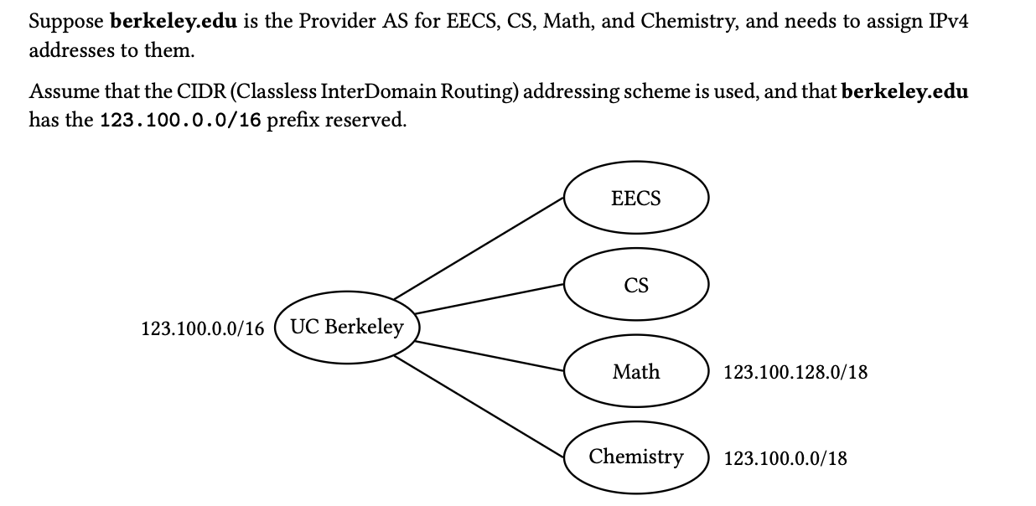
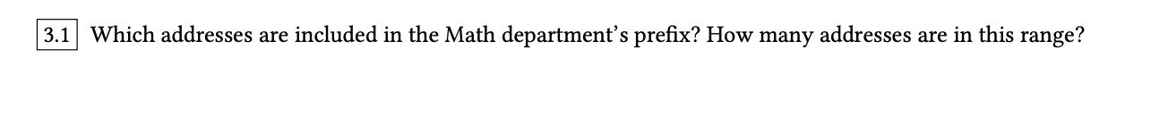
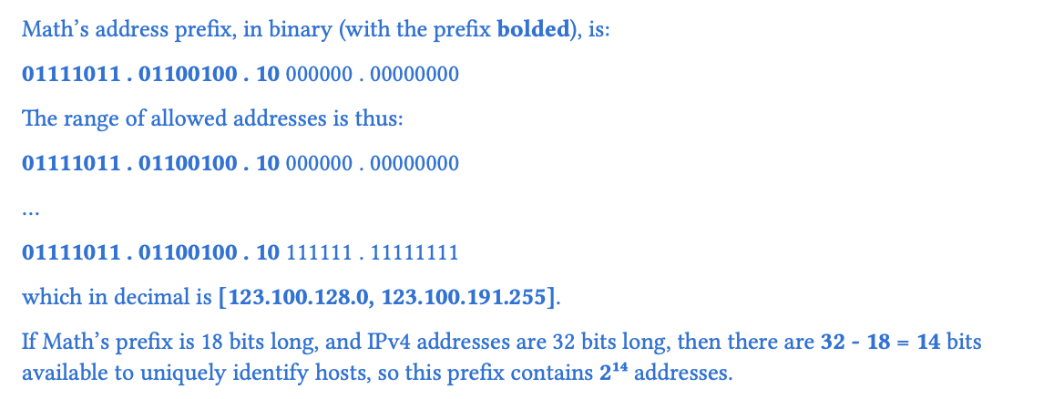

Question 3: IP Addressing

Slide 25
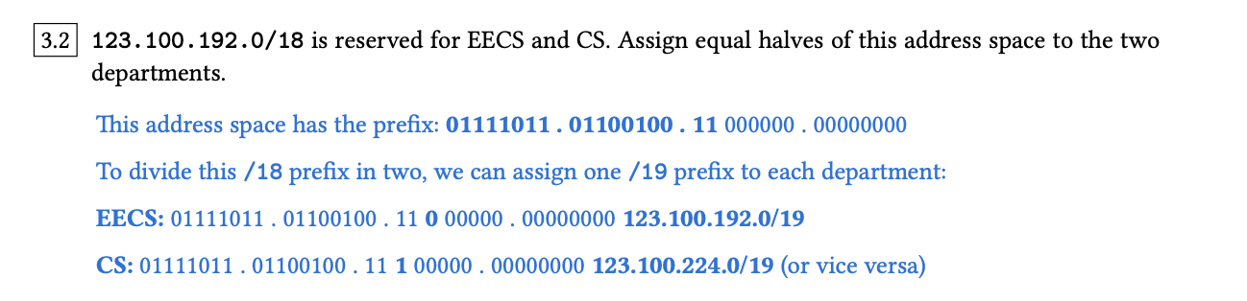
Question 3: IP Addressing

Slide 26
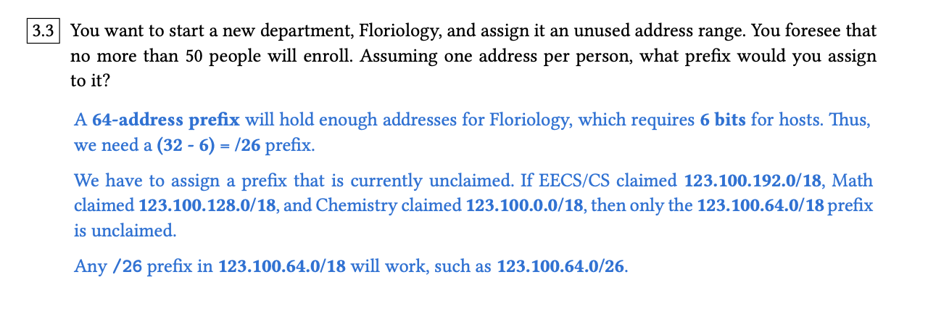
Question 3: IP Addressing

Slide 27

Questions?
Feedback Form: https://tinyurl.com/cs168-su25-disc-feedback

